Slide 1
Sales Performance Analysis (July 2001 – July 2004) Insights, Opportunities and Actions

Slide 2
Objectives
This data analysis aims to answer the strategic question “How do we increase sales, improve profitability, and enhance customer retention while addressing seasonal fluctuations and underperforming markets?”
Identifying high-performing products, markets, and sales strategies.
Addressing challenges such as seasonal fluctuation and variability in Sales team’s performance.
Deliver actionable recommendations to drive consistent growth and profitability

Slide 3
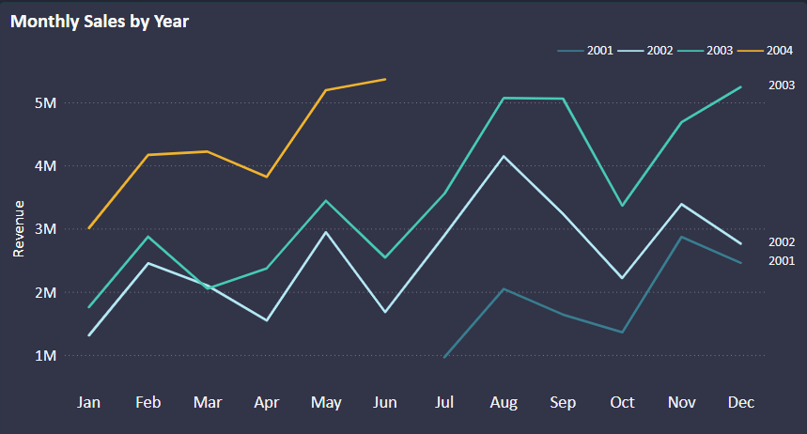
How Do Our Sales Vary Throughout the Year?
Consistent peaks in revenue in summer and holiday period
Early-year dips highlight the need to boost demand during slower seasons
Recommendations:
Launch pre-holiday campaigns to capture early shoppers.
Provide personalized offers for high-value customer segments during off-peak times.
Highest sales recorded $5.36M
Notes:
Seasonal trends can be leveraged to plan marketing and inventory

Slide 4
Which Countries Are Our Key Markets?
US was the key market (account for over 50% of the total revenue)
Other countries have shown substantial growth over time.
Recommendations:
Develop localized marketing campaigns to drive higher customer acquisition.

Slide 5
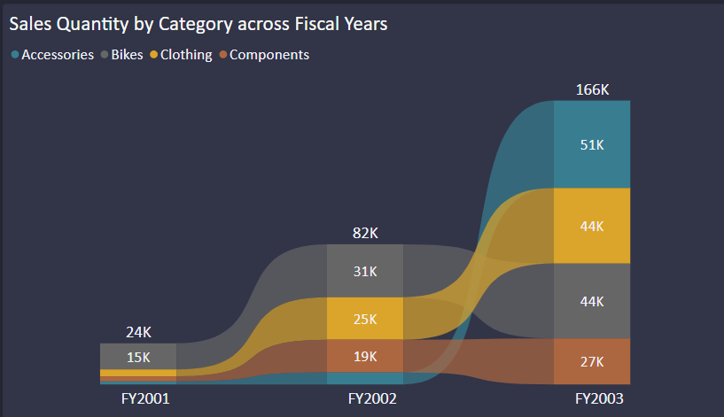
What Are Our Best-Selling Products?
Bikes lead in quantity, followed by Components
Remarkable growth in Accessories suggests increasing customer interest in complementary products
Recommendations:
Expand the product line in Accessories and Clothing to capture additional demand.
Leverage cross-sell opportunities between Bike and Components

Slide 6
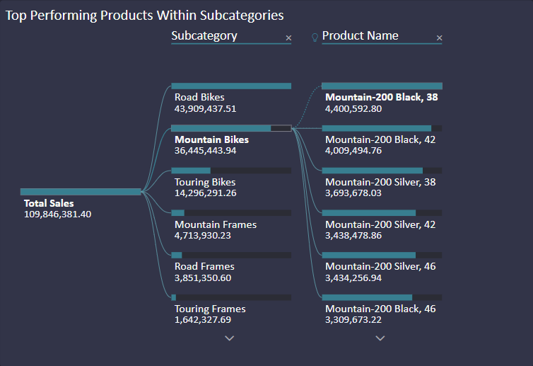
What Are Our Best-Selling Products?
Road Bikes and Mountain Bikes dominate sales
Mountain-200 Black model is the key revenue generator.
Recommendations:
Focus on marketing and improving stock levels for top-selling products to sustain their strong performance.
Develop similar products to the top performers, targeting gaps in customer preferences.

Slide 7
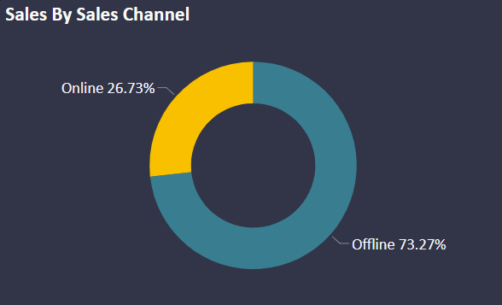
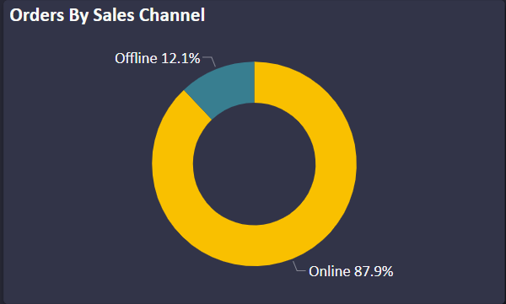
Are We Leveraging All Sales Channels Effectively?
Offline sales channels are the dominant source of revenue generation
Online sales represent an untapped growth area
Recommendations:
Retain the high-value offline customer base by offering loyalty programs or exclusive in-store experiences.
Expand digital channels and e-commerce capabilities.

Slide 8
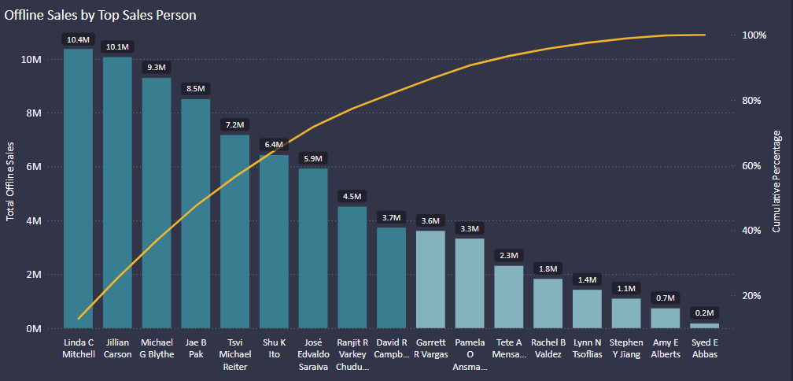
Who Drives the Most Sales?
Top 5 salesperson contribute to 56% of total offline sales, indicating heavy reliance on a few key performers.
Recommendations:
Conduct training sessions to share best practices from top salespeople across the team.
Reward top contributors to sustain motivation.

Slide 9
What Are Our Key Business Metrics?
109.85M
8.53%
31.47K
Set team-specific goals for improving repeat customer rates, profit margin and AOV
Total Sales
Profit Margin
Total Orders
275K
39.07%
4.47K
Total Products Ordered
Repeat Customer Rate
Average Order Value

Slide 10
What Actions Should We Take?
Boost repeat customers rate: Introduce loyalty programs and post-purchase engagement strategies.
Focus on high-margin categories: Prioritize Accessories and optimize Bike pricing for profit improvement
Grow international markets: Strengthen market-specific strategies in Canada, Australia and Europe.
Expand online sales: Invest in digital marketing and e-commerce.
Share sales expertise: Provide training to share best practices from top sales people.

Slide 11
What Results Can We Expect?
Revenue target: $130M.
Profit margin: Increase to 10%
Repeat Customer Rate: Increase to 45%.
Online sales: Achieve 35% revenue contribution
Product category: Increase Accessories total orders by 20%

Slide 12
Thank you

